Slide 1


Feb. 22, 2014
International Symposium on
New Direction in Higher Education for
the Development of Global Human Resources
Launching AIMS Programme in Japan
By Univeristy of Tsukuba and SEAMEO RIHED
Regionalization of Higher Education in East Asia
Kazuo Kuroda, Ph.D.
Professor, Graduate School of Asia Pacific Studies
Director, Center for the Study of International Cooperation in Education, Waseda University
Research Fellow, CRISED, University of Tsukuba
1
Notes:
1

Slide 2
Regionalization in East Asia
1. Background
Economic and political integration
ASEAN was formulated in 1967
ASEAN+3 Meeting started in 1997
Asian Regional Integration Prospect - ”East Asian Summit” started in 2005 by ASEAN+3 (10 ASEAN, China, South Korea, Japan) with Australia, New Zealand and India to discuss a long-term process for the creation of an East Asia Community
APEC(1989)→TPP
CKJ Summit started in 2008
ASEAN Community Prospect by 2015
Notes:
2

Slide 3
1. Background
Background of Policy Discussion on
Asian Regional Integration
Growing relative presence of East Asia in the world economy
Necessity for Asian regional Governance Framework
Increasing economic inter- dependence within the region
Formulating a self-sustaining economic structure, less- dependent on the West
“ASEAN Community”
“East Asian Community”
“Asia Pacific Community”
“Asianization of Asia” is witnessed in the economies of the region
3

Slide 4
Inbound Mobile Students to Three Western Countries
 | 1986 | 1996 | 2010 | 2010/1986
US | 349,610 | 453,787 | 684,807 | 1.959
France | 126,762 | 170,574 | 259,935 | 2.050
UK | 56,726 | 197,188 | 389,958 | 6.874
Total | 533,098 | 821,549 | 1,334,700 | 2.503
*
**
***
Source: * UNESCO Statistical Yearbook (1988)
** UNESCO Statistical Yearbook (1998)
*** UNESCO Global Education Digest (2012)
4
Notes:
4

Slide 5
Inbound Mobile Students to Three Asian Countries
 | 1986 | 1996 | 2010 | 2010/1986
China | 6,174 | 41,211 | 238,184(2009) | 38.578
Korea | 1,309 | 2,143 | 59,194 | 45.221
Japan | 14,960 | 53,511 | 141,599 | 9.465
Total | 20,612 | 78,409 | 438,977 | 21.297
****
****
****
*
**
***
*
**
***
Source: * UNESCO Statistical Yearbook (1988)
** UNESCO Statistical Yearbook (1998)
*** UNESCO Global Education Digest (2012)
**** Chinese Ministry of Education (2010)
5
Notes:
5

Slide 6
International Students in China, Korea and Japan
(UNESCO UIS 2012)

Slide 7
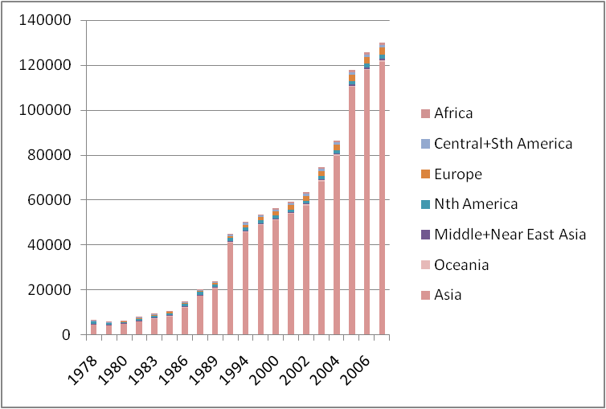
Numbers of international students in Japan
(by Regions)
Source: UNESCO Statistical Yearbook (1980-2000)
UNESCO Institute for Statistics (2003-2008)
http://stats.uis.unesco.org/unesco/TableViewer/document.aspx?ReportId=IF_Language=eng

Slide 8
Students from China in Japan

Slide 9
Students from Korea in Japan

Slide 10
ASEAN Students in Japan

Slide 11
International Students in Japan

Slide 12
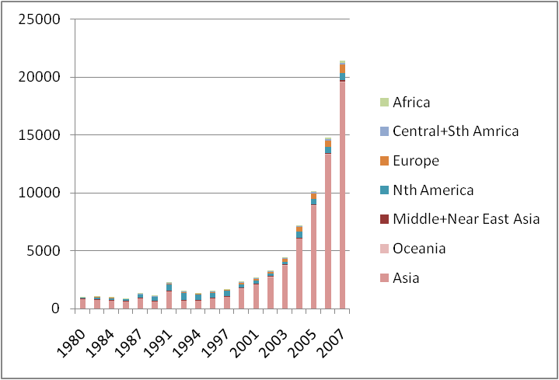
Numbers of international students in Korea
(by regions)
Source: UNESCO Statistical Yearbook (1980-2000)
UNESCO Institute for Statistics (2003-2008)
http://stats.uis.unesco.org/unesco/TableViewer/document.aspx?ReportId=IF_Language=eng

Slide 13
International Students in Korea

Slide 14
International Students in Korea

Slide 15
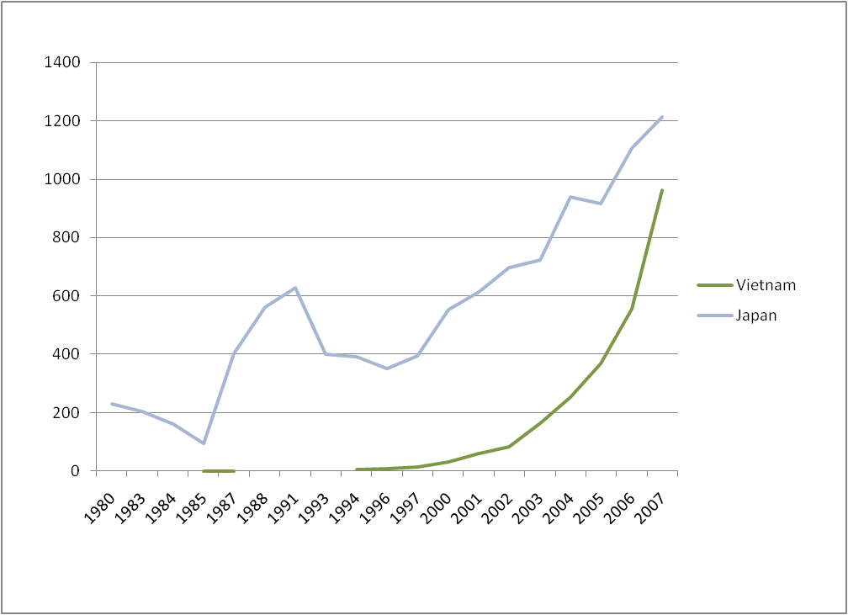
Japanese and Vietnamese students in Korea
Source: UNESCO Statistical Yearbook (1980-2000)
UNESCO Institute for Statistics (2003-2008)
http://stats.uis.unesco.org/unesco/TableViewer/document.aspx?ReportId=IF_Language=eng

Slide 16
Numbers of ASEAN students in Korea
(without Vietnam)

Slide 17
Numbers of international students in China
(by regions)
Source: Chinese Statistical Yearbook of Education (1997-2007)

Slide 18
South Korean students in China
Source: UNESCO Statistical Yearbook (1988-1994)
Chinese Statistical Yearbook of Education(1997-2007)

Slide 19
Japanese students in China
Source: UNESCO Statistical Yearbook (1988-1994)
Chinese Statistical Yearbook of Education(1997-2007)

Slide 20
Thai students in China
Source: UNESCO Statistical Yearbook (1988-1994)
Chinese Statistical Yearbook of Education(1997-2007)

Slide 21
Vietnamese students in China
Source: UNESCO Statistical Yearbook (1988-1994)
Chinese Statistical Yearbook of Education(1997-2007)

Slide 22
Indonesian students in China
Source: UNESCO Statistical Yearbook (1988-1994)
Chinese Statistical Yearbook of Education(1997-2007)

Slide 23
Numbers of international students in China (without top 5 countries)
Source: UNESCO Statistical Yearbook (1988-1994)
Chinese Statistical Yearbook of Education(1997-2007)

Slide 24
Numbers of International Students in Thailand

Slide 25
Numbers of International Students in Malaysia

Slide 26
Numbers of International Students in Vietnam

Slide 27
1. Background
Growing number of students move from Asia to Asia
  Inbound mobile students:* 1999 or circa ⇒ 2010 or circa
China
902
↓(5072%)
45757
25655
↓(337%)
86553
1387
↓ (1272%)
17633
6256 ↓(856%) 54790
Japan
Japan
11,731
↓ (532%)
62442
5,296 ↓(232%)
12326
715
↓(198%)
1428
ASEAN
Korea
ASEAN
170
↓ (2028%)
3449
Source: UNESCO Statistical Yearbook & UNESCO Global Education Digest
Note: Numbers in parenthesis indicate the percentage growth
Notes:
27

Slide 28
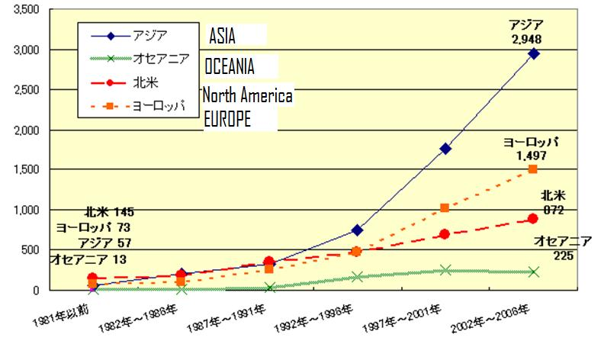
Growing number of inter-university linkages within Asia
出典：文部科学省・「大学等間交流協定締結状況調査の結果について（平成１８年１０月１日現在）」
（平成１９年９月１９日発表）

Slide 29
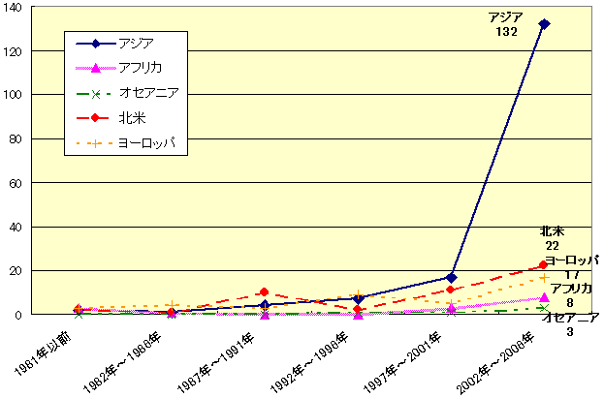
Growing number of inter-university linkages within Asia
Branch Offices Abroad by Regions
出典：文部科学省・海外拠点の設置に関する状況調査」（平成１９年９月１９日発表）

Slide 30
Japanese university branch offices abroad by countries
 | National Universities | No. | % | All Universities | No. | %
1 | China | 33 | 24 | China | 57 | 21
2 | Thailand | 17 | 12 | USA | 42 | 15
3 | USA | 12 | 9 | Thailand | 29 | 11
4 | Indonesia | 11 | 8 | S. Korea | 19 | 7
5 | Vietnam | 8 | 6 | Indonesia | 14 | 5
http://www.mext.go.jp/b_menu/houdou/19/09/07090416.htm

Slide 31
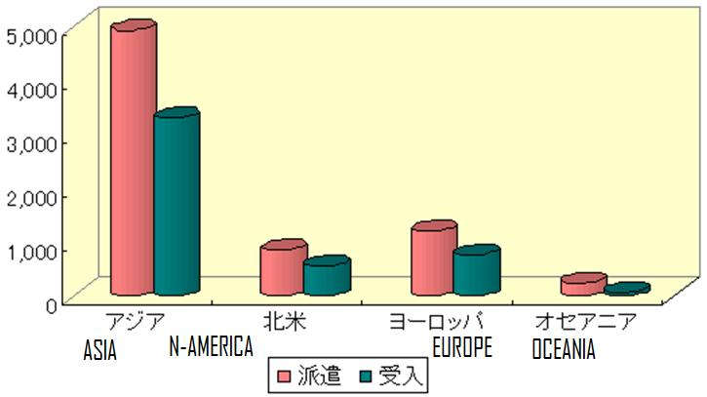
Faculty members exchange based on Japanese inter-university agreements
出典：文部科学省・「大学等間交流協定締結状況調査の結果について（平成１８年１０月１日現在）

Slide 32
Regions of partner universities for East Asian cross border collaborative degree programs
(from JICA RI Survey in 2010 n=1,041)
Rank | Region | %
1 | East Asia | 34.0
2 | West Europe | 31.3
3 | North America | 20.2
4 | Oceania and Pacific | 11.4

Slide 33
De facto of international higher education in Asia
Growing presence of Asian countries as hosts of international students.
Growing number of students move from Asia to Asia
Possible Growing number of inter-university linkages and transnational programs within Asia
“Asianization of Asia” is also confirmed in international higher education
Necessity to discuss Asian Regional Governance from the perspective of international higher education
33

Slide 34
Asian Version of ERASMUS
Speech by H.E. Mr. Yasuo Fukuda, Prime Minister of Japan
on the occasion of
the 14th International Conference on the Future of Asia (May,2008)
“I also hope to expand dramatically our exchanges among
universities within the Asia-Pacific region, and I intend to
exchange views with knowledgeable people within Japan
and abroad, aiming to come to a conclusion on this plan at the
East Asia Summit to be convened at the end of this year. Here
one may recall the "ERASMUS Programme" that has been
underway in Europe since the 1980's, and I would like to bring
about what would be called its Asian version.”

Slide 35
Joint Press Conference by
Premier Wen Jiabao of the People's Republic of China,
President Lee Myung-bak of the Republic of Korea and
Prime Minister Yukio Hatoyama of Japan following the Second China-ROK-Japan Trilateral Summit Meeting on 10 October 2009
“I also stated that what will be indispensable for trilateral cooperation is exchanges among the youth of the three countries, in particular those among university students. As one aspect of university student exchanges, we should for example actively consider permitting the interchangeability among universities of credits earned. This would naturally require a degree of consistency in the levels of the schools concerned. While I do not consider this something that is possible for all universities, we will be promoting cooperation as qualitative levels are standardized. I proposed that through such cooperation, it would be possible for the various political and psychological hurdles still remaining among our three countries to be transformed and overcome.” -Prime Minister Hatoyama

Slide 36
Japanese New Educational Cooperation Policy announced by H.E. Mr. Naoto Kan Prime Minister of Japan at the High-Level Plenary Meeting of the 65th Session of the General Assembly of the United Nations on Sep. 22nd, 2010
- Promote the creation of regional networks in higher education within and among regions in order to address common and similar education challenges by sharing experiences and knowledge of Japan and other countries, with the cooperation of Japanese universities. (AUN/SeedNet)
➔ - Promote the acceptance of international students and encourage exchange among universities with quality assurance, and foster highly specialized human resources through the promotion of international student internships.

Slide 37
The Sixteenth ASEAN Plus Three Summit 2013
“Prime Minister Abe reiterated that Japan is actively promoting assistance towards strengthening ASEAN Connectivity, attaching special importance to “People-to-People Connectivity” such as education and tourism in the APT framework. He expressed his wish to utilize the outcomes of the 11th East Asia Forum (EAF) held in Kyoto this August, which discussed the theme of enhancing tourism cooperation.”
“On education, the Prime Minister mentioned that Japan hosted the “1st APT Working Group on Mobility of Higher Education and Ensuring Quality Assurance of Higher Education among APT Countries” at the end of September in Tokyo, discussing the ways to promote mutual exchange among universities and students of the APT, while ensuring quality assurance of education. He added that Japan would like to continue to actively contribute to the efforts to enhance “People-to-People Connectivity” such as education and tourism.”
Source: Ministry of Foreign Affairs
http://www.mofa.go.jp/region/page3e_000109.html

Slide 38
Regionalization of Higher Education
Recent Moves
ASEAN + 3 Higher Education Policy Dialogue was started in 2009
SEAMEO/RIHED Malaysia-Indonesia-Thailand (M-I-T) Student Mobility Pilot Project was initiated in 2009
→ ASEAN International Mobility for Students (AIMS) Programme → Japan joined AIMS in 2013.
CAMPUS Asia (Collective Action for the Mobility Program of University Students) was started among China, Korea and Japan in 2011
ASEAN+3 University Network was formulated in 2012
ASEAN+3 Working Group on Mobility of Higher Education and Ensuring Quality Assurance of Higher Education was launched in 2013.

Slide 39
Growing Regional Quality Assurance Frameworks
ASEAN University Network for Leading Universities in Southeast Asia
SEAMEO-RIHED for Southeast Asia
APQN for Asia Pacific
Campus Asia for Northeast Asia
ASEAN + 3 Working Group
Multilayered Structure of Quality Assurance Frameworks is being formulated in Asia.

Slide 40
Possible policy objectives for Asian regional governance in higher education
1. Internationalization and Regionalization for International Understanding/International Peace
Based on the spirit of the Constitution of UNESCO “That since wars begin in the minds of men, it is in the minds of men that the defenses of peace must be constructed”
→Considering East Asian history of conflicts and wars, and political and cultural diversity of the region, this policy dimension is specially important.

Slide 41
2. Internationalization and Regionalizationfor nurturing “Global Citizen” and “Regional Identity”
Creation of “People’s Europe” and promotion of “European” identity have been recognized as main objectives of intra-regional mobility in Europe in the process of European integration.
→Also for the East Asian context.
→Not denying national identity, but formulate healthy multiple identities from local and national to regional and global.

Slide 42
3. Internationalization and Regionalization for Development and Regional Competitivenes
Based on Human Capital Theory/ Modernization Theory
Sending students abroad for development and modernization
－Policy effort of Meiji Japan and many other Asian countries.
Inviting and hosting students from developing countries as development cooperation
－Provision of scholarship to students from developing countries by ODA and private foundations
Arising recognition on the positive effect of not only sending students abroad but also hosting foreign students on their own economic prosperity.
→Increased recognition of “Brain Circulation” in the regional context.
→Internationalization and regionalization has been recognized as human resource development strategy for enhancing regional economic competitiveness in European integration
→ Asian region should also have the vision for its regional competitiveness.

Slide 43
4. Response to Marketization of International Higher Education
Corporatization and privatization of national universities.
Growing number of private universities.
Increasing self-cost recovery of educational costs.
Rapid increase of privately financed international students →Formulation of international education market
→Foreign students as “customers”
→ Education for foreign students as “export industry”
→Explosive increase students from China
・ Increasing strategic international university partnerships and alliances among Asian universities
→Formulation of Asian regional education market
→Necessity to build sound systems to ensure quality of higher education and credit transfer

Slide 44
Searching for guiding principles of Asian regional framework of higher education
The Kuala Lumpur Declaration
First East Asian Summit (in 2005)
Article 6 – We will enhance people-to-people exchange aimed at developing a "we" feeling.
Article 7 – We will encourage the sharing of ideas through greater interaction between students, academicians, researchers, artists, media, and youths among countries in East Asia.
Article 8 – We will conduct regular exchange of intellectuals, members of think tanks, religious personalities and scholars, which will benefit East Asia and the world through deeper knowledge and understanding so as to fight intolerance and improve understanding among cultures and civilizations.

Slide 45
Asian Version of ERASMUS
Should it target
(1) elite exchange through promoting linkages among elite institutions or
(2) more popular exchange through promoting system-wide harmonization?
AUN Model or UMAP Model?
Given factors
- Large diversity within a country - Large diversity across countries
- Multi-layered structure is another response to the great diversity in Asia.
2. “Asian Bologna Process” vs “Asian ERASMUS”
System harmonization rather than student mobility?
Student mobility prepares system harmonization?
→They should go together.

Slide 46
Theoretical Development
1. “Melting Pot” Integration vs. “Mosaic” Integration
– Higher Education “ASEAN Way”?
Emphasizing connectivity and embracing diversity
2. Fast developing Asian Higher Education cannot
be explained by “Dependency Model” any more.
3. Applicability of “Flying Geese Model”
What can be a new theory to explain Asian higher education?

Slide 47
アジアの大学の国際連携の理念的モデル
Regionalization as a counterforce for Center-Periphery Structure of Higher Education
or/and Frying Geese?

Slide 48
Prospecting Asian Regional Governance Framework of Higher Education
What countries should be in this framework?
Can Northeast Asia (Korea, China and Japan) have an independent framework?
How do they cooperate with ASEAN?
How about Taiwan and Hong Kong?
How about Australia and NZ?
How about North America?
- ASEAN, East Asia and Asia-Pacific.
Hub-spoke system or opposite-hub-spoke system?
- ASEAN and Northeast Asia
(2) Multi-layered regional governance frameworks should be established embracing diversity of the region. However, cohesion and cooperation among different frameworks should also be established.

Slide 49
東南アジアと北東アジアの連携過程のモデル
ASEAN+3 Integration
as a noodle ball or sandwich?
K
CKJ
C
J
ASEAN
ASEAN

Slide 50
JICA Research Institute
Research Project (2009-2011) on
“Political and Economic Implications of Cross-Border Higher Education in the Context of Asian Regional Integration”

Slide 51
Research Core Team by JICA-RI
SEAMEO/
RIHED
JICA-RI Team
Leader: Kuroda & Yuki
Advisor/Member: Yoshida & Koda
RA: Kang & Hong
Consultant Team
for Survey and Follow-up:
ASIASEED (from Japan)
Consultants in
Indonesia, Vietnam,
Cambodia for Part I
Consultant team in Malaysia
For Part I &II
Notes:
51

Slide 52
Overview
Overall Structure of Research Project
Objective: To assess socio-economic implications &
challenges of cross-border higher education in East Asia
PART 1: Overview of
Cross-border Higher Education in Asia
Current status, expected outcomes,
Changes towards regionalization of Asia?
Features of cross-border collaborative degree programs
PART 2: Case of Malaysia
Effects of cross-border
(collaborative degree) program in labor market
52
Notes:
52

Slide 53
Overview
Structure of PART 1
Overall question:
What are political and economic implications
of internationalization of higher education in Asia?
Three types of surveys:
PART 1-1
Leading universities
in ASEAN plus 5
(about 300)
PART 1-2
Cross-border collaborative degree programs in leading universities
(about 1000 programs)
(e.g. twinning)
PART 1-3
Industry organizations
(15 orgs)
Notes:
53

Slide 54
Previous relevant studies
Overview
Not much, but one: 2003, 2005, 2009 International Association of Universities (IAU) Global Survey Report – led by Prof. Jane Knight
What is different from 2005 IAU Global Survey
Different recipients
  IAU: 3,057 IAU member institutions in 95 countries
  JICA: analytically selected 300 “leading” universities in 15 Asian countries with relatively high response rate of approximately 43%.
JICA included additional dimensions to survey
Notes:
Objective: To develop a framework for evaluating internationalization of higher education
Method: Questionnaire aims to find the current status of universities’ international activities, and their managerial policies and purposes in the context of internationalization of the universities.
54

Slide 55
Overview of the survey for 300 “leading” universities
Notes:
55

Slide 56
Survey for 300 universities
Slelection method
Survey Target
  Identify approximately 300 institutions that can be considered as "leading universities" in ASEAN and plus 5 countries, while ensuring representatives from ASEAN countries & avoiding over-representativeness from non-ASEAN.
Selection Method
  1st step, we identify universities that appear in any list of 3 university rankings* and 8 international (or regional) university organizations‘ memberships* (*next slide)☆
  ⇒ Applied for 8 ASEAN countries
  2nd, identify universities that appear at least twice in the above lists ⇒ Applied for 2 ASEAN countries and China
  3rd, identify universities that appear at least three times in the above lists ⇒ Applied for the rest of countries
  Lastly, added 22 universities suggested by the participants from the Bangkok Workshop.
Notes:
56

Slide 57
Survey for 300 universities
Selection method (continued)
University rankings used
  ①Times Higher Education-QS World University Rankings 2008 (Complete Rankings) (400 ranked)
  ②Shanghai Jiao Tong University, Academic Ranking of World Universities 2008 (500 ranked)
  ③Ranking Web of World Universities 2008, by Webometrics (5000 ranked)
International (or regional) organizations used
  ①UMAP: University Mobility and Asian and the Pacific (324)
  ②AUN: ASEAN University Network (21)
  ③IAU: International Association of Universities (593)
  ④IARU: International Alliance of Research Universities (10)
  ⑤APRU: Association of Pacific Rim Universities (42)
  ⑥AERU: Association of East Asian Research Universities (17)
  ⑦ASAIHL: Association of Southeast Asian Institutions of Higher Learning (165)
  ⑧AUAP: Association of Universities of Asia and the Pacific (206)
Notes:
57
Why we selected them?
For international organization, the number in parenthesis shows, for each association, how many universities are in, and of which how many are in Asean, and plus 5)

Slide 58
Survey for 300 universities

Slide 59
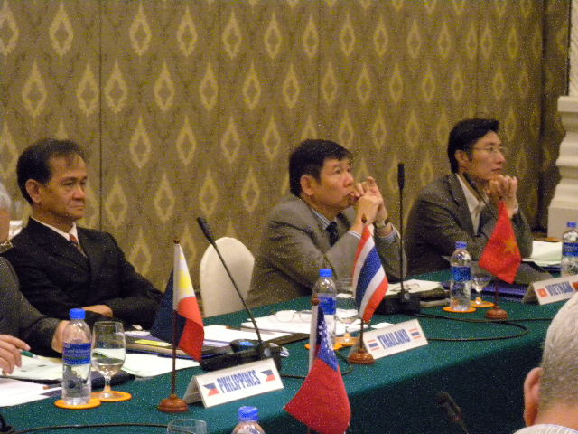
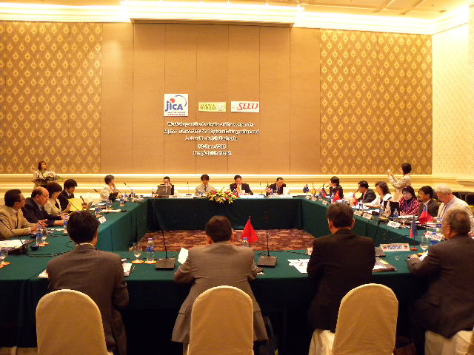
Workshop in Bangkok, Thailand
(June 30, 2009)
Survey for 300 universities
Collaborated with SEAMEO-RIHED
Discussed the research project to receive inputs and endorsements.
Attended by policy makers and researchers from ASEAN+3+1 countries
Notes:
59

Slide 60
Survey for 300 universities
Notes:
60

Slide 61
Response rates
Survey for 300 universities
＊
* May be less due to the effective answer rate by questions

Slide 62
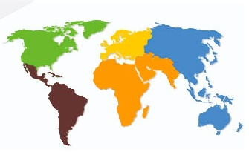
Dimension : Regional partnerships
Survey for 300 universities
Western Europe
Central Asia
North America
Central and Eastern Europe
Northeast Asia
Arab States
Sub Sahara Africa
South and West Asia
Latin America and Caribbean
Southeast Asia
Oceania and Pacific
62
Notes:
62

Slide 63
Activeness of cross-border activities
63

Slide 64
Findings for dimension 1
Conventional activities such as “cross-border institutional agreement” and “outgoing mobility opportunities for faculty members” are regarded as having more vigor than innovative activities such as “cross-border collaborative degree programs” and “use of ICT for cross-border distance education.”
While the lists of cross-border activities in the ranking order of the degree of activity have not changed significantly over time, the vigor of innovative activities is expected to grow extensively in the future.

Slide 65
Significance of expected outcomes
65

Slide 66
Findings for dimension 2
The most highly prioritized expected outcome are “to improve the international visibility and reputation of [their] own university”, “to improve quality of education” and “to achieve research excellence”.
The expected outcome “to generate revenue for your own institution” is low, despite the fact that for profit-side of internationalization is increasing in numerous countries.
Asian leading universities prioritize academic expected outcomes ahead of the economic expected outcomes.

Slide 67
Activeness of regional partnerships for overall cross-border activities: Southeast Asia
Highly active: 4, Fairy active: 3, Moderately active: 2, Slightly active: 1, Not active: 0

Slide 68
Degree of activity of overall cross-border activities' partner regions for Southeast Asia

Slide 69
Activeness of regional partnerships for overall cross-border activities: Northeast Asia
Highly active: 4, Fairy active: 3, Moderately active: 2, Slightly active: 1, Not active: 0

Slide 70
Degree of activity of overall cross-border activities' partner regions for Northeast Asia

Slide 71
Activeness of regional partnerships for “Outgoing mobility opportunities for students”: ASEAN & Northeast Asia
71
Highly active: 4, Fairy active: 3, Moderately active: 2, Slightly active: 1, Not active: 0

Slide 72
Activeness of regional partnerships for “Cross-border research collaboration”: ASEAN & Northeast Asia
72
Highly active: 4, Fairy active: 3, Moderately active: 2, Slightly active: 1, Not active: 0

Slide 73
Activeness of regional partnerships for “Cross-border institutional agreement”: ASEAN & Northeast Asia
73
Highly active: 4, Fairy active: 3, Moderately active: 2, Slightly active: 1, Not active: 0

Slide 74
Preliminary findings
Activeness of regional partnerships for “Acceptance of foreign students”: ASEAN & Northeast Asia
74
Highly active: 4, Fairy active: 3, Moderately active: 2, Slightly active: 1, Not active: 0

Slide 75
Activeness of regional partnerships for “Cross-border collaborative degree program”: ASEAN & Northeast Asia
75
Highly active: 4, Fairy active: 3, Moderately active: 2, Slightly active: 1, Not active: 0

Slide 76
Summary
1. Regional partners (for overall cross-border activities) :
Southeast Asia: Southeast & Northeast Asia are the most active partners followed by North America and Western Europe.
Northeast Asia: North America and Southeast Asia are the most active partners, while Northeast Asia and Western Europe are almost equally active partners.
2. Regional partners (for each cross-border activity) :
Southeast Asia: Southeast Asia is the most active regional partner for the
different types of cross-border activities, except for “cross-border collaborative degree programs,” which has Western Europe as the most active regional partner.
Northeast Asia: North America is the most active regional partner for the
different types of cross-border activities, except for “Acceptance of foreign
students,” which has Northeast Asia as the most active regional partner
followed by Southeast Asia.

Slide 77
Preliminary findings
Summary (continued)
2 Regional partners (for each cross-border activity) :
Southeast Asia:
The top 5 active regional partners are the same for the different types of cross-border activities, except for “acceptance of foreign student,” which includes South and West Asia instead of North America.
Northeast Asia:
The top 5 active regional partners are the same for the different types of cross-border activities, except for “Acceptance of foreign students,” which has South and West Asia instead of Oceania and Pacific as one of the top 5 active regional partners.

Slide 78
Suggestions for East Asian Regional Framework of Higher Education on intra-sub-regional cooperation
First, the finding shows the deeper collaboration related to higher education within each of the sub-regions, Southeast Asia and Northeast Asia. As the findings generally indicate, Southeast Asian universities most prioritize building partnerships with the other universities in their own region, and Northeast Asian universities also place high priority on building partnerships with the other universities in their own region. These findings support the current regional policy directions. Southeast Asia began discussing regionalization in the education sector within its own region with the construction of the Socio-Cultural Community, and in 2009, Northeast Asia initiated the creation of the Asian version of ERASMUS, CAMPUS ASIA, within its own region. These ongoing active intra sub-regional collaborations may lead to the development of a concrete regional framework of higher education for both Southeast Asia and Northeast Asia.

Slide 79
Suggestions for East Asian Regional Framework of Higher Education on “East Asia” regional cooperation
Second, for overall cross-border activities, both Southeast Asia and Northeast Asia highly prioritize each other as partners for their cross-border activities, even compared to their priorities for other parts of Asia and the Pacific. This fact indicates that integrating the two sub-regions may be a functional next step in constructing a regional higher education framework in East Asia. Therefore, with ongoing active partnerships between the two regions, developing a framework that integrates the two sub-regions, often referred to as ASEAN+3, may function as a useful coordinating forum. In the venue of ASEAN+3, the issue of integration (or harmonization) in higher education has not yet been prioritized. Nevertheless, many expect an increase in awareness of the importance of regional integration in the higher education sector among ASEAN+3 countries in the future.

Slide 80
Suggestions for East Asian Regional Framework of Higher Education on Inter-regional cooperation
Thirdly, although the process of the East Asian regionalization of higher education may begin with an ASEAN+3 structure, it may not end there; rather, it may expand to involve strong complementary relationships with other active regions of partners. Our finding of North America as the most active (and projected to be the most active) partner for Northeast Asian universities clearly indicates that an appropriate partnership with North America needs to be included in the future dialogue for a regional higher education framework in East Asia. North America does not necessarily have to be included, but appropriate policy linkage with North America is necessary for East Asia as we have between Europe and Asia with the ASEM framework.

Slide 81
References
Altbach, Philip G. and Selvaratnam Viswanathan. 1989. From Dependence to Autonomy, The
Development of Asian Universities. Kluwer Academic Publishers.
Altbach, Philip G. and Umakoshi Toru. 2004. Asian Universities, Historical Perspectives and
Contemporary Challenges. The Johns Hopkins University Press.
Carnoy, Martin. 1995. International Encyclopedia of Education. Pergamon.
Challenger Concept. 2008. Education Guide Malaysia. Challenger Concept.
Clark, Robin E., Guy R. Neave, and Burton R. Clark. 1992. The Encyclopedia of Higher Education.
Pergamon.
Huang, Futao. 2006. Transnational Higher Education in Asia and the Pacific Region. Research Institute for Higher Education Hiroshima University.
Husen, Torsten, and T. Neville Postalethwiate. 1994. The International Encyclopedia of Education.
Pergamon.
International Association of Universities. 1997. World List of Universities and Other Institutions of
Higher Education. Palgrave Macmillan.
Knight, Jane. 2005. “Cross-Border Education: Not Just Students on the Move.” Journal of International
Higher Education, no. 41 (Fall 2005), http://www.bc.edu/bc_org/avp/soe/cihe/newsletter/Number41/p2_Knight.htm (accessed September 14, 2009).
Knight, Jane. 2006. 2005 IAU Global Survey Report: Internationalization of Higher Education: New Directions, New Challenges. International Association Universities,
Knight, Jane. 2008. Higher Education in Turmoil. Sense Publishers. Rotterdam, Challenger Concept.
2004. Education Guide Malaysia. Challenger Concept,
OECD, and IBRD/World Bank. 2007. Cross-border Tertiary Education, A way Towards Capacity
Development. OECD and IBRD/World Bank.

Slide 82

Thank you!

